Slide 1
The Hubble

Slide 2
The Hubble
Hubble is a user friendly platform for the aspirants who wants to earn their right to receive development opportunities.
Aspirants, trainers have a common platform and can share information with one to one, one to many and many to many configurations.
Jobs available for newly learnt skills are alerted to the aspirants.

Slide 3
Technologies used:
Frontend:
HTML
CSS
Bootstrap
Backend: PHP
Database: MySQL lite

Slide 4
Features of Hubble
Counselling
Various courses offered- Videos, Documents
Forums - Open platform for Q&A
Feedback system
Chatbox-One to One interaction

Slide 5
1.
Counselling the Aspirants
-The First Approach

Slide 6
Forums are kept open to both trainers and aspirants, so that any query can be posted and can get solutions/experiences as reply from the members on the app.

Slide 7
2. Explore New Technologies
-The Second Approach

Slide 8
Courses streaming
This platform enables trainers to upload the latest technologies and soft skills related videos which can reach the aspirants when they register for the courses announced.
Documents, pdf materials are made available so that users can download them and can read them when feasible to them.

Slide 9
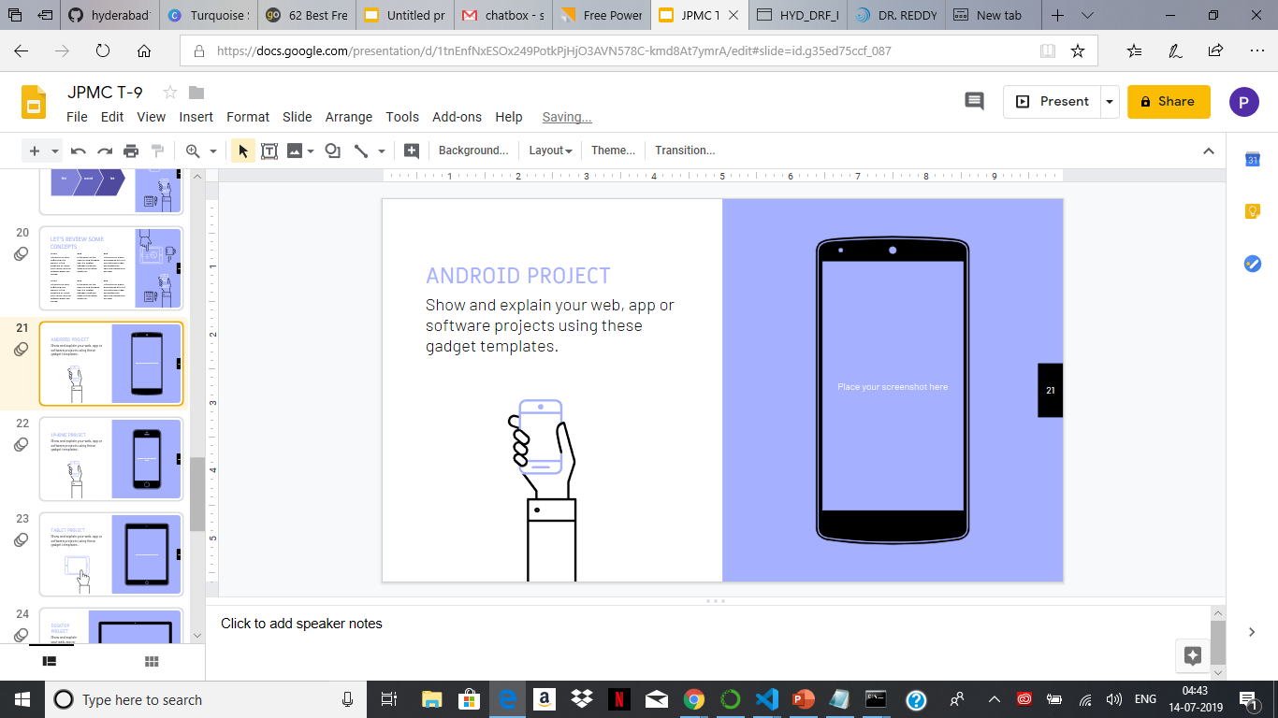
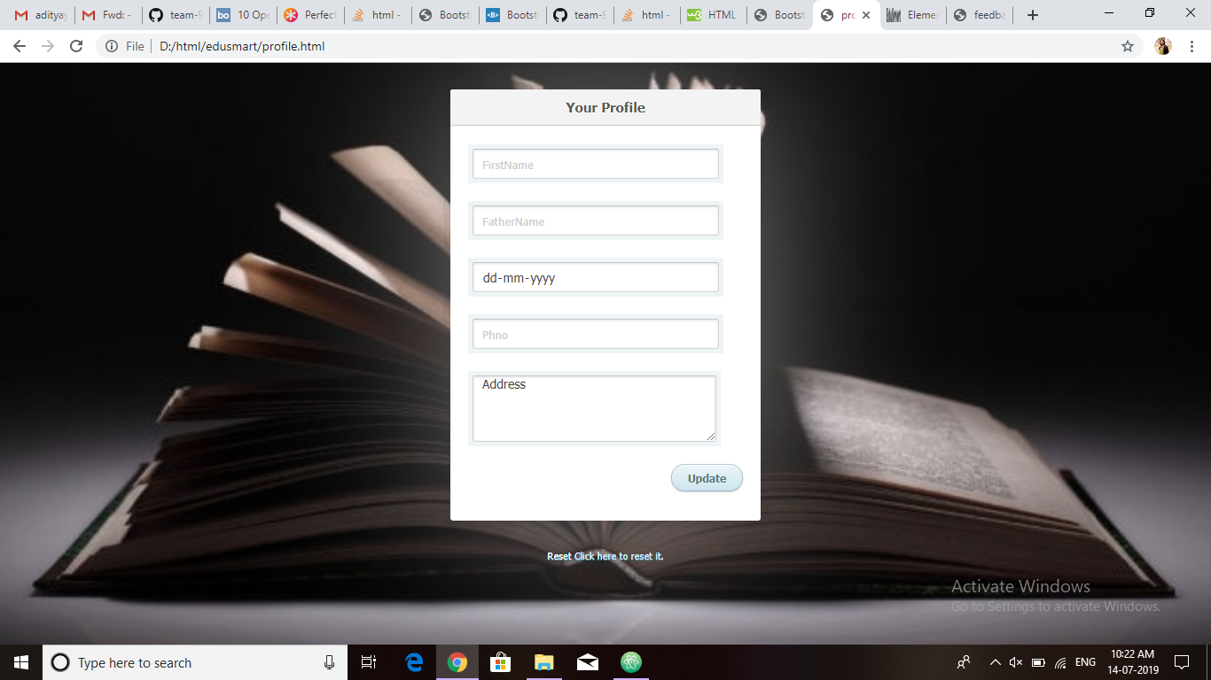
3.Track of Profile & Rewards
Profile
Platform allows users to frequently update the skill sets they have and avail the best job opportunities.
Rewards
Based on activities and updations a user makes in the app, active booster parameter is varied. The higher the active booster, more is the advantage to the user in terms of career.

Slide 10
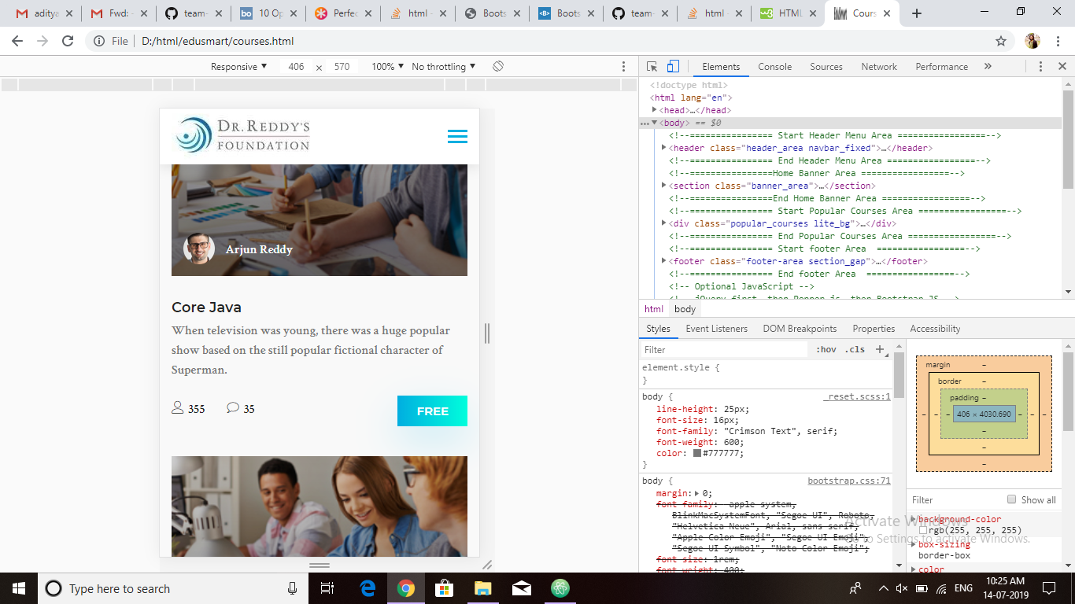
4. Job offers and Feedback
Job Offers
Job notifications are sent to the aspirants based on technologies they upload in profile and the activity status of the aspirant.
Feedback
Feedback for courses attended by aspirants is taken in order to assess the trainer capabilities which contributes to his career.

Slide 11
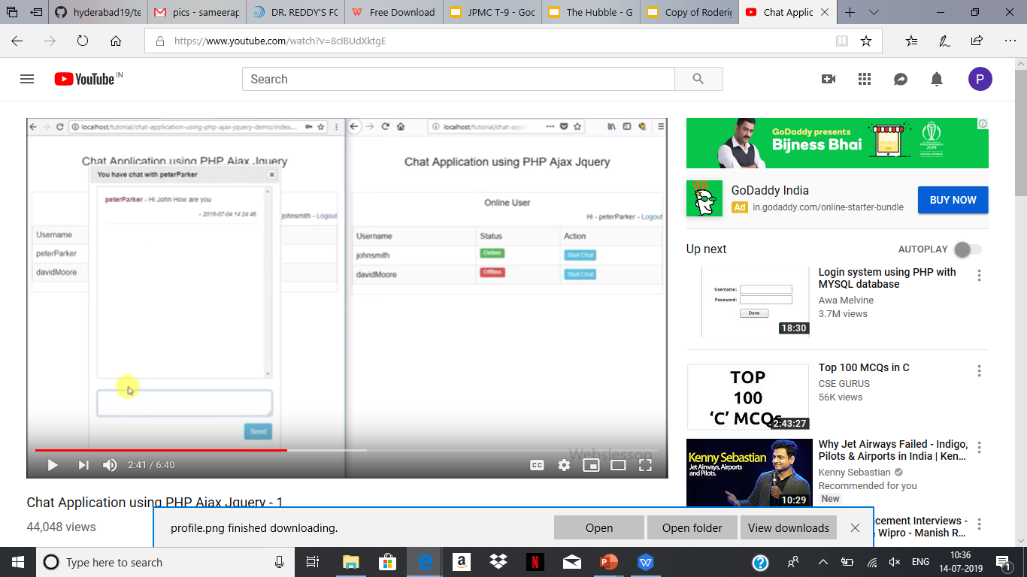
5. Chatbox
One to one interaction of aspirants is possible by implementing the chatbox.
Aspirant can talk to the specific trainees that they would like to and get inputs from them.

Slide 12
With this platform
Aspirant can boost his confidence by clarifying his/her doubts and getting to know the experiences shared by people with user friendly environment.
Learn latest technologies and can have better job opportunities with improved soft skills.

Slide 13
Future Implementations
Assessments
More part of Gamific-ation
Offline version of app

Slide 14

THANKS!
Any questions?

Slide 15
CREDITS
Special thanks to our mentors and SMEs for guiding and directing us throughout the course of development.

